Slide 1
Programming Language

Slide 2
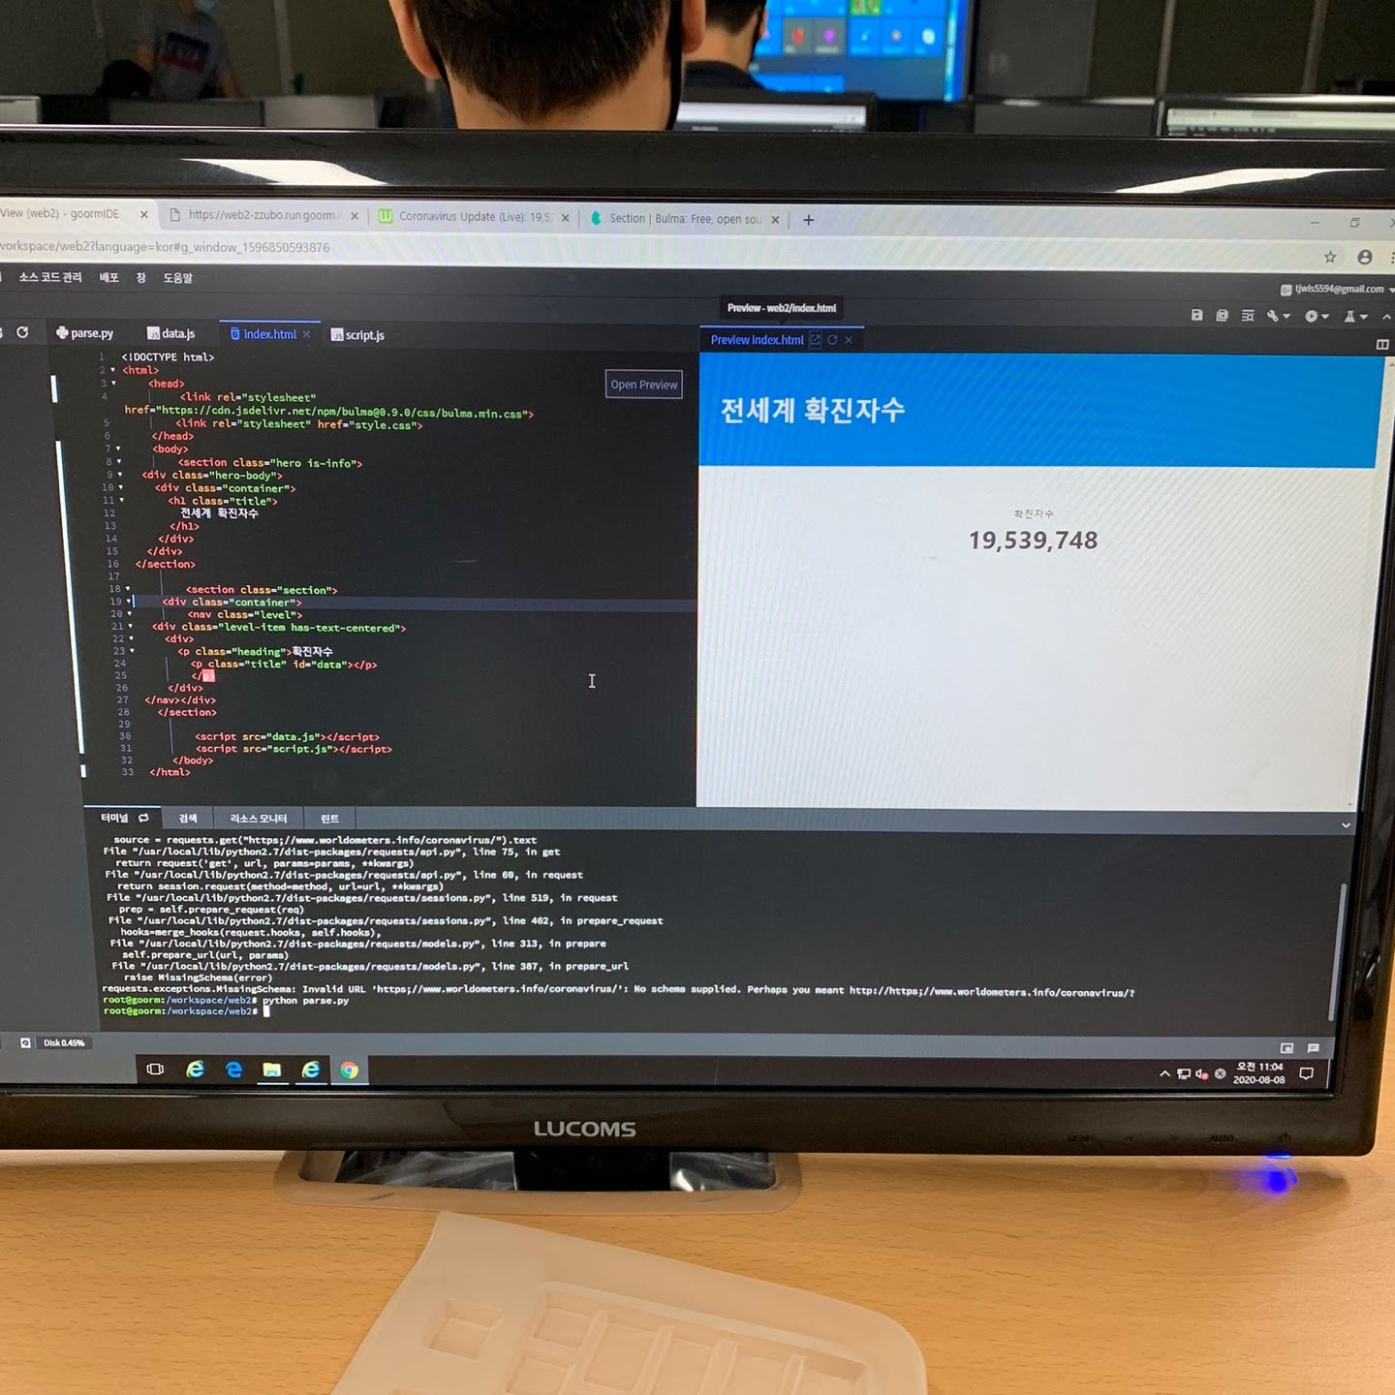

Slide 3
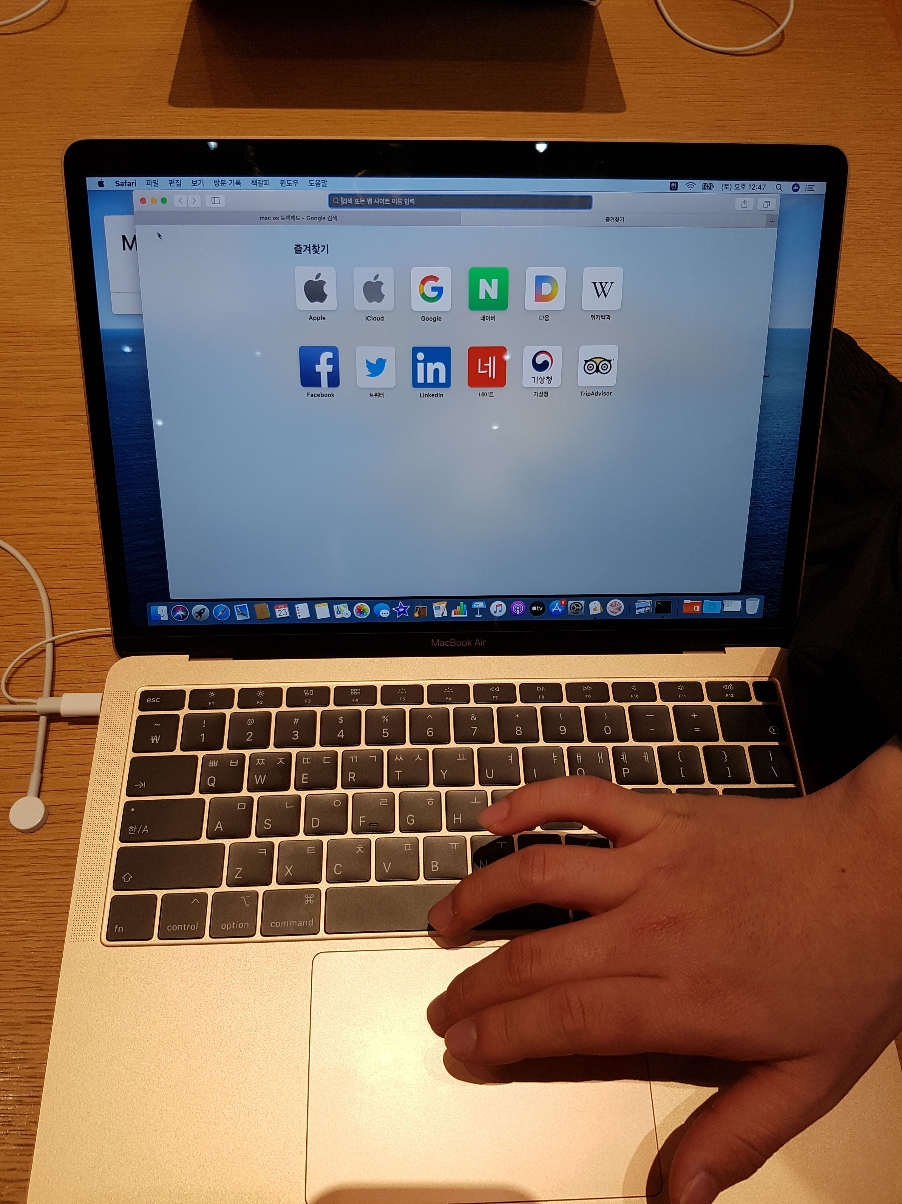

Slide 4
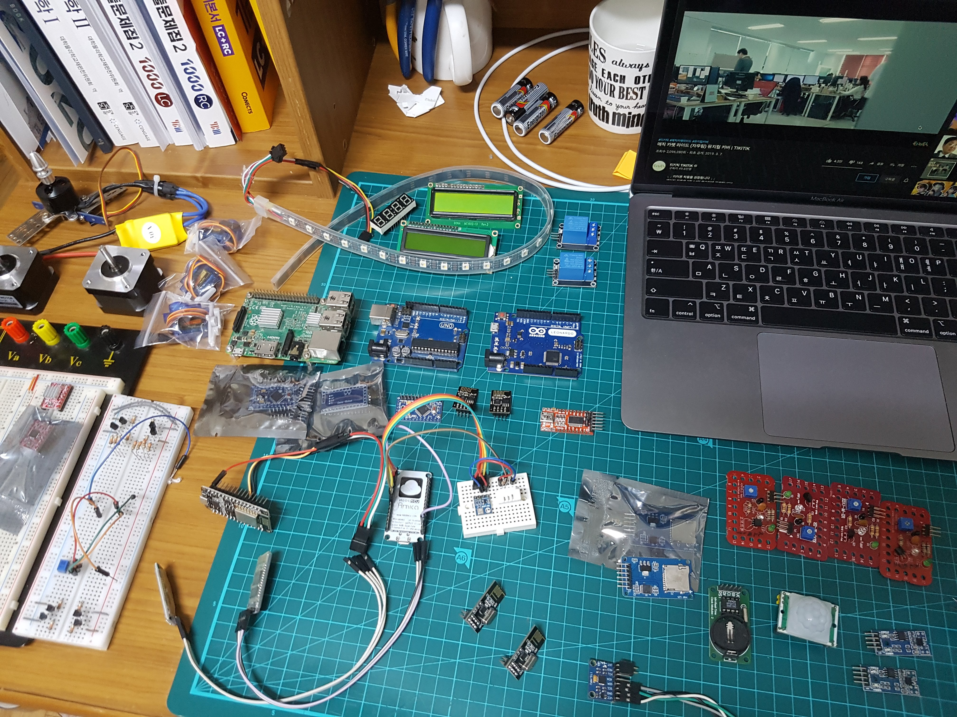

Slide 5


Slide 6
1011 0000 1010 0011

Slide 7
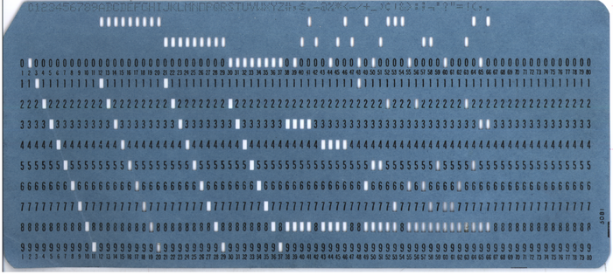
1011 0000 1010 0011

Slide 8

1011 0000 1010 0011
ADD ax, bx

Slide 9

1011 0000 1010 0011
ADD ax, bx

Slide 10
1011 0000 1010 0011
ADD ax, bx
x = 1 + 2

Slide 11
1011 0000 1010 0011
ADD ax, bx
x = 1 + 2

Slide 12
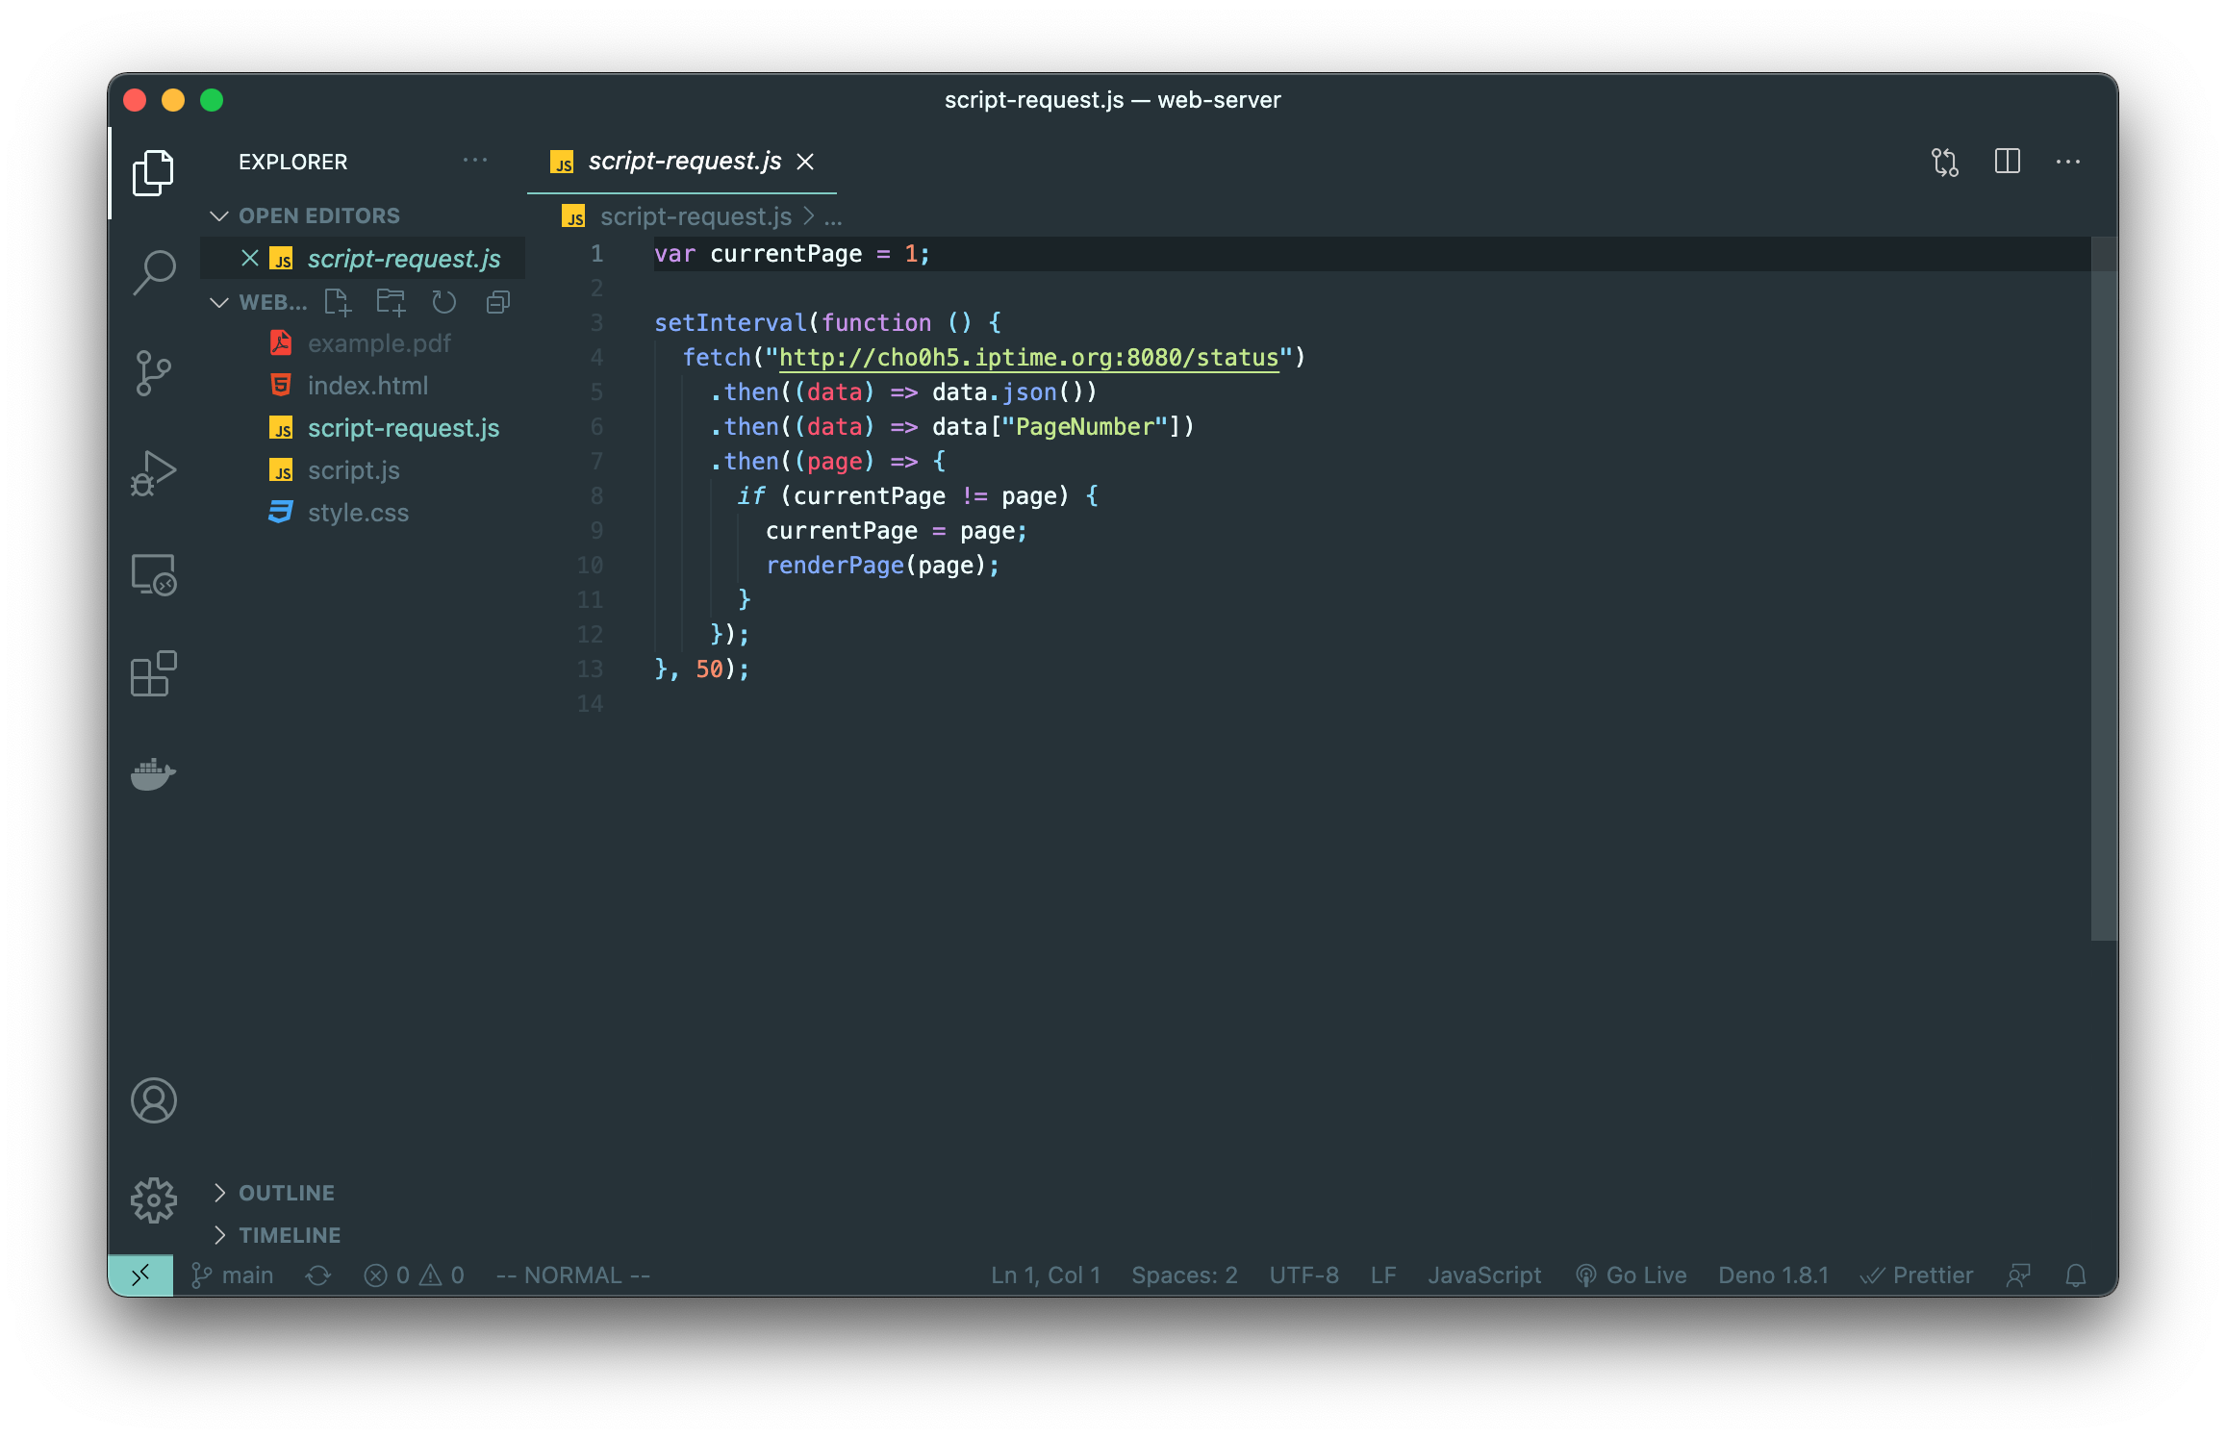

Slide 13




lewing@isc.tamu.edu Larry Ewing and The GIMP
https://commons.wikimedia.org/wiki/File:HTML5-logo.svg
https://creativecommons.org/licenses/by/3.0

Slide 14

https://github.com/wonjong-computer/2021

